Slide 1
Credit Scoring and Statistical Techniques
By Yousef Allam

Slide 2
Credit Scoring

Slide 3
Agenda 1
Today’s questions
What is Credit Scoring?
What does a Credit Report contains?
Who collects Credit Reports?
Why is Credit Scoring important?
How is Credit Score calculated?

Slide 4
Credit Report
What is a Credit Report?
Personal information.
Bank accounts.
Financial Transactions and Missed Payments.
Entities that have previously requested Credit Report.

Slide 5
Credit Reporting Agencies
Who collects Credit Reports?
Collect and maintain Credit Reports.
From financial institutions.
Generate Credit Scores.
Egypt’s Credit reporting agency.

Slide 6
Credit Score
What is Credit Score?
Reflects Creditworthiness.
Factors affecting Credit Score.
FICO System.
Low score consequences.
Why use a Credit Score system?

Slide 7
Statistical Techniques

Slide 8
Agenda 2
Today’s questions
Why do we need credit scoring systems?
What are the different statistical techniques used?
How do they work?
What are the advantages and disadvantages?

Slide 9
Credit Scoring System
Why is Credit Scoring system important?
Guidelines for acceptance and rules.
Complex calculation.
The need for accurate results.
The need for statistical techniques.
Type of statistical techniques.

Slide 10
Types of Statistical Techniques

Slide 11
Logistic Regression

Slide 12
Logistic Regression
What is Logistic Regression?
Relation between dependent and independent variables
Continuous or categorical independent variables
Dichotomous(binary) the output.
Predict the likelihood of “yes” or “no” outcomes.

Slide 13
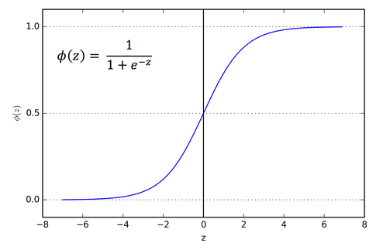
Logistic Regression
Sigmoid Function
Assigns the probabilities to discrete outcomes
Forms an S-shaped graph
The model sets a threshold.
Differentiate between the different classes.

Slide 14
Logistic Regression
Types of Logistic Regression
Binary 2 outcomes only. (Yes or No)
Multinomial three or more categories without ordering. (Vegan, Non-veg, Vegetarian)
Ordinal three or more categories with ordering. (Movie Rating from 1 to 5)

Slide 15
Logistic Regression
Advantages | Disadvantages
No assumptions about data | Assumption of linearity between variables
Extendable to multiple classes | Requires no multicollinearity between variables
Less inclined to overfitting | Tedious data preparation
Very efficient for linearly separable data | Not applicable for nor-linear problems
Quick and easy implementation | Not immune to missing data
Lower training time | Outliers could distort the estimation of coefficients
Predicted features gives inference

Slide 16
Discriminant Analysis

Slide 17
Discriminant Analysis
What is Discriminant Analysis?
Classify observations into non-overlapping groups.
Dimensionality reduction technique.
Create a new axis.
Two criteria are used to create a new axis
Maximize distance.
Minimize variation

Slide 18
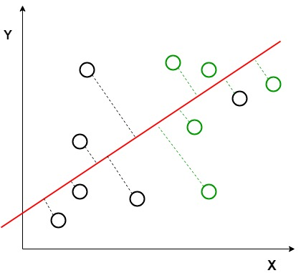

||
V

Slide 19
Discriminant Analysis
Discriminant Function
Default and Non-Default.
Passes through centroids
Needs the number of groups minus one functions.
Function includes one or more attributes

Slide 20
Discriminant Analysis
Advantages | Disadvantages
simple, fast and portable algorithm | requires unrealistic assumptions
minimizes the variance in the dataset | Does not give good results in case of unbalanced dataset
reduces the curse of dimensionality | Not suitable for non-linear problems

Slide 21
Decision Trees

Slide 22
Decision Trees
What is Decision Trees?
Human thinking steps
Starts with a group of records
Searches for appropriate attribute and cut-off value.
Measurement for splitting nodes
Entropy
Information gain

Slide 23
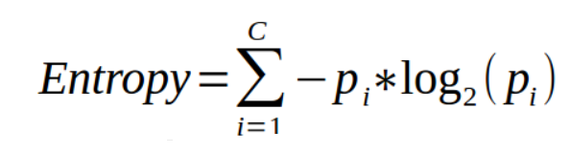
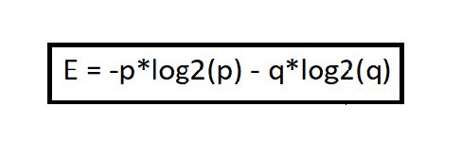
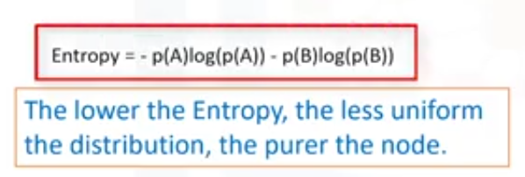
Decision Trees
Entropy
Measure of randomness and uncertainty.

Slide 24
Decision Trees
Information Gain
Measure of Entropy reduction.
How much information a feature provides.

Slide 25
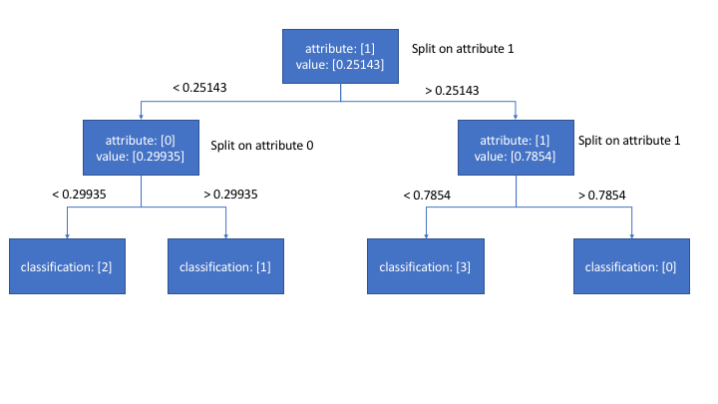
Decision Trees

Slide 26
Decision Trees
Advantages | Disadvantages
perfect for visual representation | Decision trees tend to overfit
doesn’t require a lot of preprocessing | Small changes in the data can affect prediction greatly
automatically handle missing values | Adding a new data point can lead to re-generation
robust to outliers | Not suitable for large datasets
No assumptions are required about the data | High time complexity
Feature selection happens automatically | Outliers could distort the estimation of coefficients
predict both continuous and discrete values | Too many numerical variables take a lot of time for training
classify non-linearly separable data

Slide 27
Credit Scoring and Default Risk Prediction: A Comparative Study between Discriminant Analysis & Logistic Regression
Article in International Journal of Economics and Finance . Match 2016
By Zaghdoudi Khemais, Djebali Nesrine & Mezni Mohamed

Slide 28
Credit Scoring and Default Risk Prediction
Abstract
Develop models for predicting default risk of SMEs.
Using Logistic Regression and Discriminant Analysis.
195 credit files divided into 5 sectors.
“industry, agriculture, tourism, trade and services”
The two scoring techniques have a statistically significant power.

Slide 29
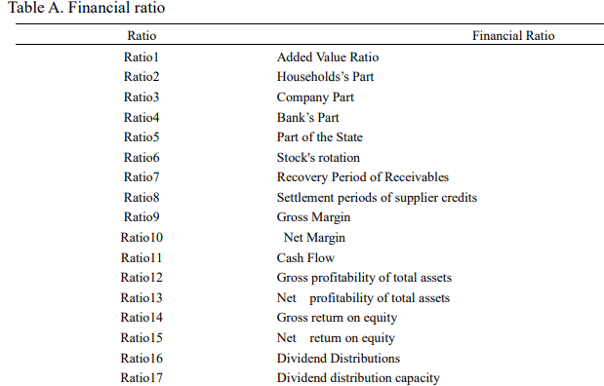

Slide 30
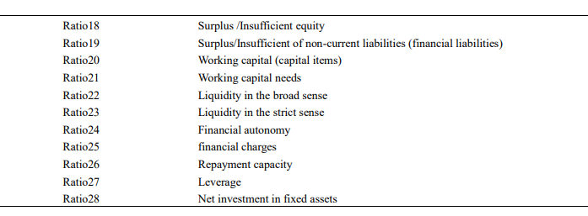

Slide 31
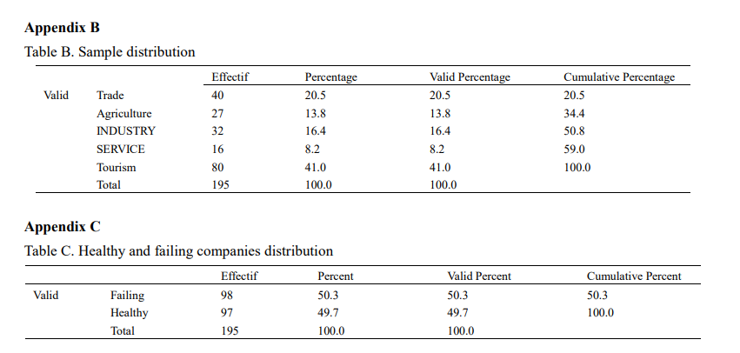

Slide 32
Statistical Techniques
Target and conditions
Classify the companies to good or bad.
Obtaining an estimate for the model
Healthy companies are rated by “1”.
Failing companies are rated by “0”.

Slide 33
Discriminant Analysis

Slide 34

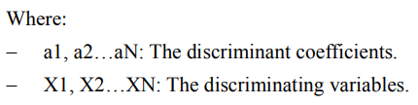
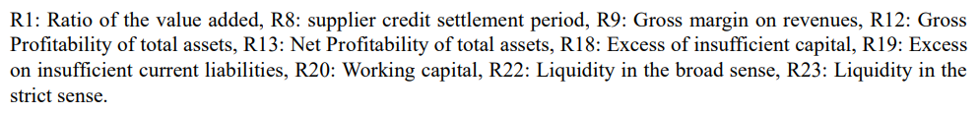
Discriminant Analysis
Tests
Wilks’s Lambda Test.
Prove existence of relationships
Tests value is always between 0 and 1.
1 means classes are equal.
0 means it has great significance.

Slide 35
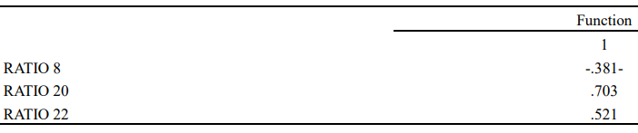
Discriminant Analysis
Discrimination Function
Wilks’s Lambda Test
Choosing variables
Calculating the weights.
Score function

Slide 36
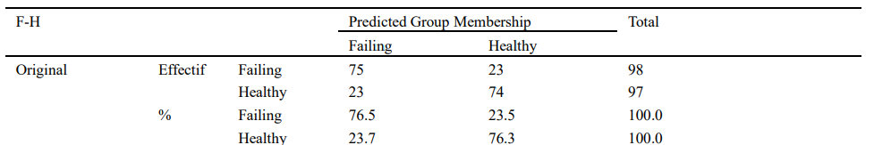

Discriminant Analysis
Discriminant Analysis Results

Slide 37
Logistic Regression

Slide 38

Logistic Regression
Logistic Regression Function

Slide 39


Logistic Regression
Logistic Regression Results

Slide 40
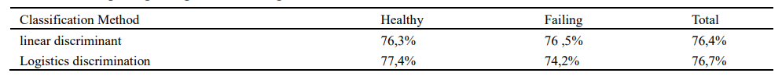
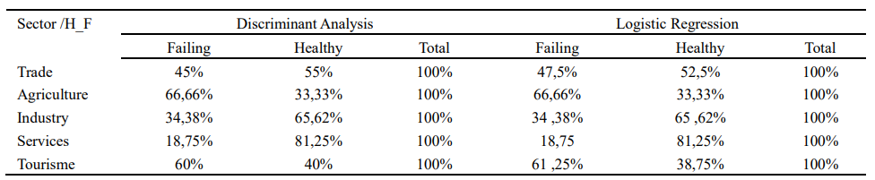
Results
Research Results

Slide 41
References
References
https://www.techtarget.com/searchbusinessanalytics/definition/logistic-regression#:~:text=Logistic%20regression%20is%20a%20statistical,or%20more%20existing%20independent%20variables.
https://towardsdatascience.com/logistic-regression-detailed-overview-46c4da4303bc
https://citeseerx.ist.psu.edu/viewdoc/download?doi=10.1.1.1024.2660&rep=rep1&type=pdf
https://www.kdnuggets.com/2022/07/logistic-regression-work.html
https://www.analyticsvidhya.com/blog/2021/07/an-introduction-to-logistic-regression/
https://learn.g2.com/logistic-regression
https://www.geeksforgeeks.org/understanding-logistic-regression/
https://towardsdatascience.com/understanding-logistic-regression-9b02c2aec102
https://www.youtube.com/watch?v=azXCzI57Yfc
https://stattrek.com/multiple-regression/discriminant-analysis
https://www.statisticssolutions.com/discriminant-analysis/
https://www.ibm.com/docs/en/spss-statistics/25.0.0?topic=features-discriminant-analysis
https://machinelearningmastery.com/linear-discriminant-analysis-for-machine-learning/
https://www.tutorialspoint.com/what-is-the-use-of-discriminant-analysis-in-credit-score-model
https://www.geeksforgeeks.org/ml-linear-discriminant-analysis/#:~:text=Linear%20Discriminant%20Analysis%20or%20Normal,separating%20two%20or%20more%20classes.
https://mpra.ub.uni-muenchen.de/8156/1/MPRA_paper_8156.pdf
https://www.javatpoint.com
https://www.tutorialspoint.com/what-is-the-use-of-discriminant-analysis-in-credit-score-model
https://www.ncbi.nlm.nih.gov/pmc/articles/PMC2798100/
https://en.wikipedia.org/wiki/Linear_discriminant_analysis
https://www.educba.com/decision-tree-advantages-and-disadvantages/
http://theprofessionalspoint.blogspot.com/2019/02/advantages-and-disadvantages-of.html#:~:text=24%20February%202019-,Advantages%20and%20Disadvantages%20of%20Decision%20Trees%20in%20Machine%20Learning,to%20overfitting%20of%20the%20data.
https://hastie.su.domains/ISLR2/ISLRv2_website.pdf
https://www.researchgate.net/profile/Aboul-Ella-Hassanien/publication/316994943_Linear_discriminant_analysis_A_detailed_tutorial/links/5958dc46a6fdcc2beca94342/Linear-discriminant-analysis-A-detailed-tutorial.pdf
https://hastie.su.domains/ISLR2/ISLRv2_website.pdf
https://stats.oarc.ucla.edu/stata/dae/discriminant-function-analysis/
https://www.sciencedirect.com/topics/medicine-and-dentistry/discriminant-analysis
https://www.researchgate.net/profile/Djebali-Nesrine/publication/299473359_Credit_Scoring_and_Default_Risk_Prediction_A_Comparative_Study_between_Discriminant_Analysis_Logistic_Regression/links/57f3a48d08ae8da3ce535648/Credit-Scoring-and-Default-Risk-Prediction-A-Comparative-Study-between-Discriminant-Analysis-Logistic-Regression.pdf

Slide 42
Any Question?

Slide 43
Thank you

